Slide 1
ECE 340 Lecture 38
Introduction to Bipolar Junction Transistor (BJT)
Next 4 lectures on the BJT
A bit to remember about transistors. Two characteristics:
  1) Amplification: a small signal (I or V, terminal #1) can control a large signal (usually I, flowing between terminal #2-#3).
  Think of a tiny faucet controlling the amount of water flow through a giant hose. How many terminals? ____________.
  Why is the water faucet/hose analogy particularly useful for sub-100 nm transistors today? _________________.
  2) Switching: the transistor can be turned on/off.
Two main types of transistors studied in ECE 340:
  1) Field effect transistors (FET): small input voltage (faucet) controls large output current (hose)
  2) Bipolar junction transistor (BJT): small input current (faucet) controls large output current (hose)

Slide 2
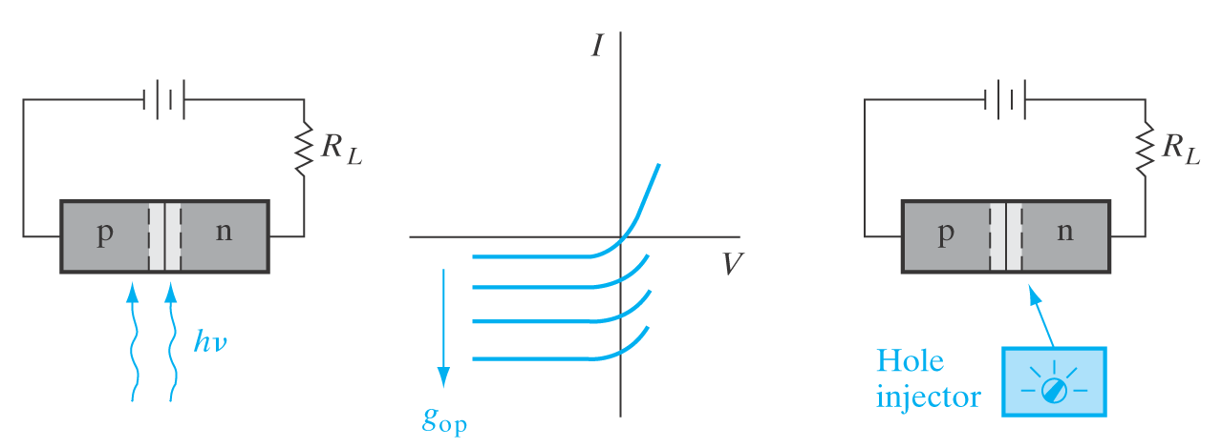
Note, BJT = current-controlled current switch = always has some current flowing → power dissipation
This is its Achilles’ heel compared to the MOSFET, more power dissipation → limits integration levels per chip
  BJTs have been gradually replaced with CMOS especially in high-density logic apps over past 30 yrs.
  But, BJTs are better for analog circuit applications → higher speed and gain.
Remember the P-N
diode with lights on!
Reverse bias (V = V_{p}–V_{n} < 0) current with lights off = small.
When light is on, it creates________ in the middle________ region. These are swept by the E-field already present and modulate the__________.

Slide 3
Can we inject holes electrically rather than optically?!
  Yes, we know how to inject holes electrically. Take a p+n junction. When forward biased, it injects holes into the n-region unilaterally:
  Now put the hole injector (forward biased p+n) and current modulator (reverse biased np) together:

Slide 4
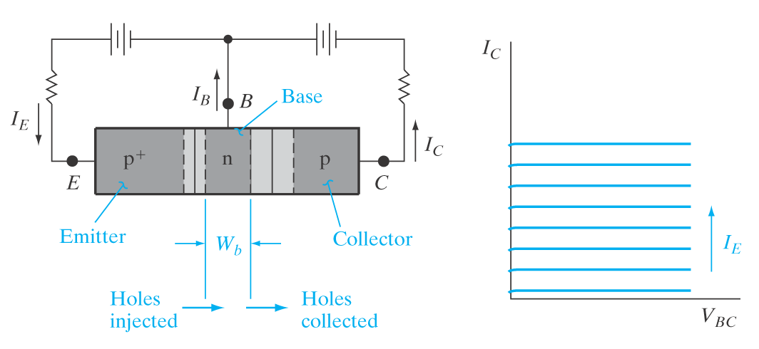
Draw like Streetman & Banerjee:
Emitter (p+) injects holes into reverse-biased Base-Collector.
For Collector to… collect all (most) holes we need Base to be quite_________. Mathematically, W_{b} << ______.
Properly biased, with BJT “on” the voltages are: V_{EB} > ____ and V_{CB} < ____ (same as V_{BC} > ____).
If so, then almost all injected holes are collected: I_{E} ≈ I_{C} are the “large” currents here (water passing through the hose).

Slide 5
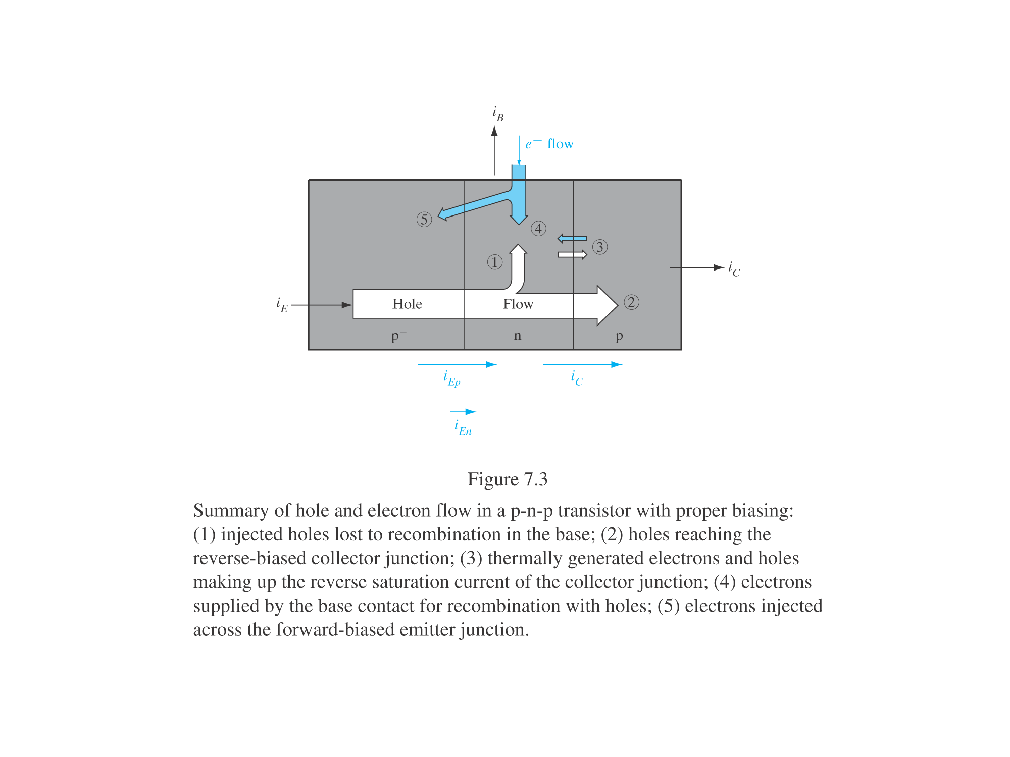
Is there a Base current I_{B}? What does it consist of?
Base current I_{B} (remember
base is n-type for pnp BJT):
  Some electrons____________ with injected holes.
  Some electrons injected into p+ (forward biased EB).
  Few electrons from thermal generation in reverse-biased CB junction
Base current I_{B} is small, but it’s there. See figure for signs.

Slide 6
In a well-designed BJT, I_{E} ≈ I_{C} ≈ 100I_{B}
We can write from current continuity: ______________
There are both PNP and NPN bipolar transistors.
  Easier to study PNP because current flows in direction of holes. But NPN is similar, replace holes w/ electrons and keep track of signs!
  Intuitively (dimensions, doping being equal), which is faster?

Slide 7
BJT performance parameters:
Emitter efficiency:
Base transport factor:
Current transfer ratio:
Current amplification (common emitter gain):

Slide 8
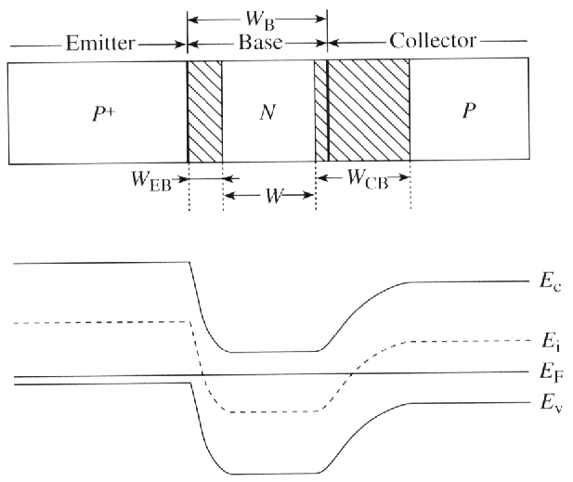
Let’s begin to understand BJT physics. Think of it as two independent PN junctions:
Band diagram in equilibrium (all I=0):
Electric field:
Charge density:

Slide 9
ECE 340 Lecture 39
Narrow-Base BJT
What did we learn so far? What is special about the Base?
Try to make things simple(r):
  E → B current is all holes (p+ to n)
  Holes diffuse across base, ignore drift (how come?)
  Ignore any small reverse current at CB junction
  Ignore recombination (for now)

Slide 10
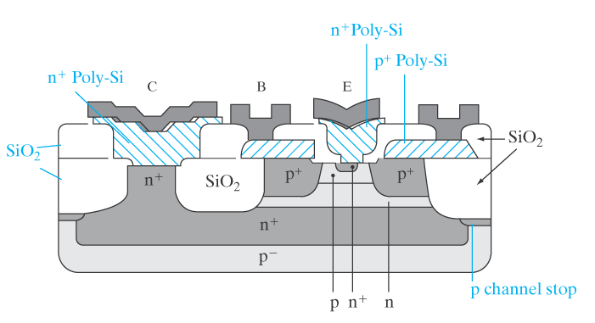
Reality check. This is what a more realistic BJT looks like:
What kind of BJT?
What is the cross-sectional area?
What’s with all the extra n+ and p+ regions?
What’s with all the SiO₂?

Slide 11
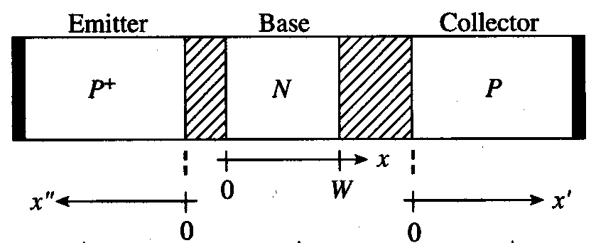
Back to our simplified analysis of the P+NP (V_{EB}>0, V_{CB}<0):
We know all action is minority carrier diffusion, focus there:
In fact, all action is hole diffusion in base, get Δp there:
Where p_{n} = n_{i}²/N_{B}

Slide 12
Now we can almost calculate collector (hole) current…
… because I get a nice (linear) slope from knowing W_{B} << Lp
This is a narrow-base BJT, and we want it that way! Then:
Remember, only holes are “captured” by the Collector. Why?

Slide 13
To get Emitter current, don’t forget there is a small electron injection component from the n-type Base.
Draw these injected (minority) electrons in Emitter:
And remember the expression from long-base diode:
We can finally write the entire Emitter current:

Slide 14
Now we can calculate a lot of those “merit” parameters listed in the last lecture, like Emitter efficiency,
Finally, what is the Base current?
The current gain is

Slide 15
Expression for gain β can be simplified two ways:
  1) If there is no recombination in the Base, and I_{B} is due only to electron injection back into Emitter:
  2) If Emitter efficiency is perfect (γ = 1) and I_{B} is due only to recombination in the Base:
  Where L_{p} = (D_{p}τ_{p})^{1/2} is hole diffusion length in the Base, and by construction W_{B} << L_{p}.
  If you are not given D_{p} how do you calculate it?

Slide 16
Clearly (by construction) β >> 1 so we get CURRENT GAIN!
Why? (qualitatively). Draw energy band diagram, think about what happens if I pull a small current from Base (inject electrons).

Slide 17
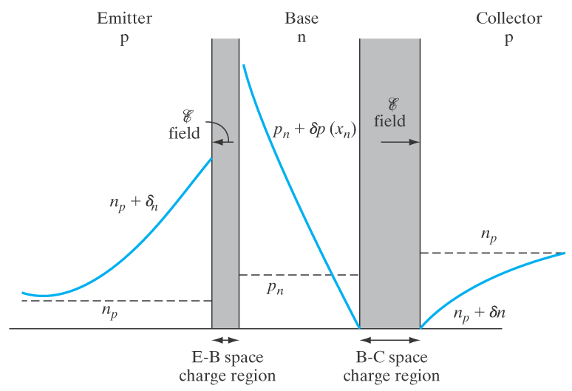
ECE 340 Lecture 40
BJT Normal Mode and Gain
Two main pictures for P+NP
bipolar transistors:

Slide 18
Recap our simple model for P+NP bipolar operation:
Current continuity: I_{E} = I_{B} + I_{C}
When EB diode is forward biased (V_{EB} > 0), Emitter current I_{E} has two components:
  Holes it injects into the Base (I_{Ep})
  Electrons the n-type Base injects into it (I_{En})
Base current has two components:
  Electrons it draws from terminal to supply I_{En}
  Electrons it draws from terminal to recombine with injected holes (Q_{B}/τ_{p})
Collector current is made up of holes it manages to sweep (“collect”) from the ones injected by Emitter, minus those that have recombined in the Base, strictly speaking I_{C} = I_{Ep} – Q_{B}/τ_{p}
Is Collector current made up of any electrons?
Does our current continuity assumption hold?
When and what can we ignore to simplify our life?

Slide 19
One more look at the equations for P+NP:
Where, remember L_{p} = (D_{p}τ_{p})^{1/2} for holes in the Base.
How do we keep things straight?
Tip #1: Remember who is injecting what where (if it’s into the Base, then use Base parameters like D_{p}, L_{p} W_{B} and N_{B})
Tip #2: If the terminal is “narrow” use its width instead of the minority carrier diffusion length there
Tip #3: Q_{B,stored} is just the area under the stored charge triangle in the Base (1/2 * height * width…)
Tip #4: On notation, if it’s unambiguous we don’t need the extra E/B/C super/subscript (Base is the only n-type chunk here, so D_{p} must be for… minority holes in the Base!)
Tip #5: Remember the (e^{x} - 1) factor is what multiplies the equilibrium minority carrier concentration (e.g. n_{i}²/N_{B})

Slide 20
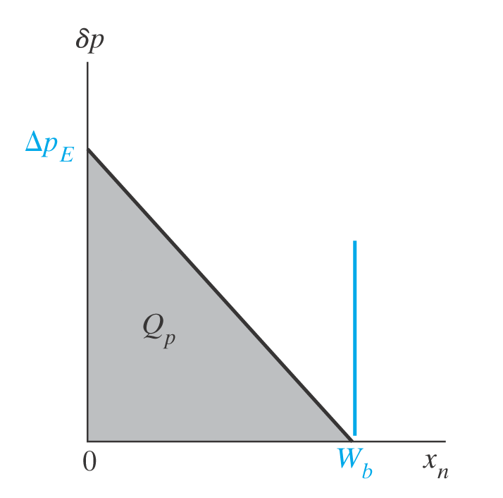
So, why do I have GAIN?! (I_{C}/I_{B} ~ 100)
Ex: P+NP bipolar with N_{E}=10¹⁸ cm⁻³ and N_{B}=10¹⁷ cm⁻³. The quasi-neutral region width in the emitter is 1 μm and 0.2 μm in the base. Use μ_{n}=1000 cm²/Vs and μ_{p}=300 cm²/Vs. The minority carrier lifetimes are 10 ns. Calculate the emitter efficiency, the base transport factor, and the current gain of this transistor biased in the forward active mode. Assume there is no recombination in the depletion regions. (Note: are the emitter and base “narrow” or “wide”?)

