Slide 1
Electrons & Phonons
Ohm’s & Fourier’s Laws
Mobility & Thermal Conductivity
Heat Capacity
Wiedemann-Franz Relationship
Size Effects and Breakdown of Classical Laws

Slide 2
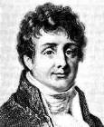
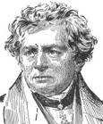
Thermal Resistance, Electrical Resistance
P = I² × R
∆T = P × R_{TH}
∆ V = I × R
R = f(∆T)
Fourier’s Law (1822)
Ohm’s Law (1827)

Slide 3
Poisson and Fourier’s Equations
drift
diffusion
diffusion only
Note: check units!
Some other differences:
Charge can be fixed or mobile; Fermions vs. bosons…

Slide 4
Mosquitoes on a Windy Day
Some are slow
Some are fast
Some go against the wind
n
n(v₀)dv
wind
v
dv
Also characterized by some spatial distribution and average
n(x,y,z)
Can be characterized by some velocity histogram (distribution and average)

Slide 5
Calculating Mosquito Current Density
Area A
dr
Current = # Mosquitoes through A per second
N_{A} = n(r,v)*Vol = n(r,v)*A*dr
Per area per second: J_{A} = dN_{A}/dt = n(dr/dt) = nv

Slide 6
Charge and Energy Current Density
Area A
dr
What if mosquitoes carry charge (q) or energy (E) each?
Charge current: J_{q} = qnv → Units?
Energy current: J_{E} = Env → Units?
Notes:
units are C/m2/s = A/m2
and J/m2/s = W/m2

Slide 7
Particles or Waves?
Recall, particles are also “matter waves” (de Broglie)
Momentum can be written in either picture
So can energy
Acknowledging this, we usually write n(k) or n(E)

Slide 8
Charge and Energy Flux (Current)
Total number of particles in the distribution:
Charge & energy current density (flux):
Of course, these are usually integrals (Slide 11)
Notes:
label density of states, and occupation probability function

Slide 9
What is the Density of States g(k)?
Number of parking spaces in a parking lot
g(k) = number of quantum states in device per unit volume
How “big” is one state and how many particles in it?
L
“d” dimensions
L
“s” spins or polarizations
L

Slide 10
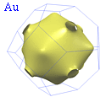
Constant Energy Surface in 1-, 2-, 3-D
k_{y}
k_{z}
k
0
k_{x}
k_{x}
k_{y}
k_{x}
m_{l} ≈ 0.91m₀
m_{t} ≈ 0.19m₀
Si
For isotropic m*, the constant energy surface is a sphere in 3-D k-space, circle in 2-D k-space, etc.
Ellipsoids for Si conduction band
Odd shapes for most metals

Slide 11
Counting States in 1-, 2-, or 3-D
k_{y}
k_{z}
k
0
k_{x}
k_{x}
k_{y}
k_{x}
System has N particles (n=N/V), total energy U (u=U/V)
This is obtained by counting states, e.g. in 3-D:

Slide 12
What is the Probability Distribution?
Probability (0 ≤ f(k) ≤ 1) that a parking spot is occupied
Probability must be properly normalized
Just like the number of particles must add up
But people generally prefer to work with energy distributions, so we convert everything to E instead of k, and work with integrals rather than sums

Slide 13
Fermi-Dirac vs. Bose-Einstein Statistics
∞
T=0
T=0
T=300
T=300
T=1000
T=1000
Fermions = half-integer spin
(electrons, protons, neutrons)
Bosons = integer spin
(phonons, photons, ¹²C nuclei)
In the limit of high energy, both reduce to the classical Boltzmann statistics:

Slide 14
Temperature and (Non-)Equilibrium
Statistical distributions (FD or BE) establish a link between temperature, quantum state, and energy level
Particles in thermal equilibrium obey FD or BE statistics
Hence temperature is a measure of the internal energy of a system in thermal equilibrium
What if (through an external process) I greatly boost occupation of electrons at E=0.1 eV?
Result: “hot electrons” with effective temperature, e.g., at T=1000 K
Non-equilibrium distribution
T=300 K
T=1000 K

Slide 15
Counting Free Electrons in a 3-D Metal
spin
# states in k-space
spherical shell
Convert integral over k to integral over E since we know energy distribution (for electrons, Fermi-Dirac)

Slide 16
Counting Free Electrons Over E
At T = 0, all states up to E_{F} are filled, and above are empty
This also serves as a definition of E_{F}
E
E_{F}
So E_{F} >> k_{B}T for most temperatures

Slide 17
Density of States in 1-, 2-, 3-D
(with the nearly-free electron model and quadratic energy bands!)
van Hove
singularities

Slide 18
Electronic Properties of Real Metals
Metal | n (10²⁸ m⁻³) | m*/m₀ | v_{F} (10⁶ m/s)
Cu | 8.45 | 1.38 | 1.57
Ag | 5.85 | 1.00 | 1.39
Au | 5.90 | 1.14 | 1.39
Al | 18.06 | 1.48 | 2.02
Pb | 13.20 | 1.97 | 1.82
Fermi equi-energy surface
usually not a sphere
source: C. Kittel (1996)
In practice, E_{F} and m* must be determined experimentally
m* ≠ m₀ due to electron-electron and electron-ion interactions (electrons are not entirely “free”)
Fermi energy: E_{F} = m*v_{F}²/2

Slide 19
Energy Density and Heat Capacity
similar to before,
but don’t forget E(k)
For nearly-free electron gas, heat capacity is linear in T and << 3/2nk_{B} we’d get from equipartition
Why so small? And what are the units for C_{V}?

Slide 20
Heat Capacity of Non-Interacting Gas
Simplest example, e.g. low-pressure monatomic gas
Back to the mosquito cloud
From classical equipartition each molecule has energy 1/2k_{B}T per degree of motion (here, translational)
Hence the heat capacity is simply
Why is C_{V} of electrons in metal so much lower if they are nearly free?

Slide 21
Current Density and Energy Flux
Current density:
What if f(k) is a symmetric distribution?
Energy flux:
Check units?

Slide 22
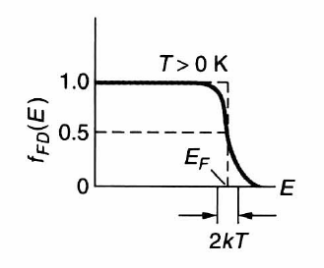
Conduction in Metals
Balance equation for forces on electrons (q < 0)
Balance equation for energy of electrons
Current (only electrons near E_{F} contribute!)

Slide 23
Boltzmann Transport Equation (BTE)
The particle distribution (mosquitoes or electrons) evolves in a seven-dimensional phase space f(x,y,z,k_{x},k_{y},k_{z},t)
The BTE is just a way of “bookkeeping” particles which:
  move in geometric space (dx = vdt)
  accelerate in momentum space (dv = adt)
  scatter
Consider a small control volume drdk
Rate of change
of particles both
in dr and dk
Net spatial
inflow due to
velocity v(k)
Net inflow due
to acceleration by
external forces
Net inflow due
to scattering
=
+
+

Slide 24
Relaxation Time Approximation (RTA)
Where recall v = and F =
In the “relaxation time approximation” (RTA) the system is not driven too far from equilibrium
Where f ⁰(E) is the equilibrium distribution (e.g. Fermi-Dirac)
And f’(E) is the distribution departure from equilibrium
Notes:
RTA: assume the distribution function has two parts: a large component shaped like the equilibrium function, and a small perturbation obtained by solving the BTE

Slide 25
BTE in Steady-State (∂f/∂t = 0)
Still in RTA, approximate f on left-side by f ⁰
Furthermore by chain rule:
So we can obtain the non-equilibrium distribution
And now we can directly calculate the current & flux

Slide 26
Current Density and Mobility
This may be converted to an integral over energy
Assume F is along z: (dimension d=1,2,3)
(Lundstrom, 2000)
(Ferry, 1997)
Assumption: position-independent relaxation time (τ)

Slide 27
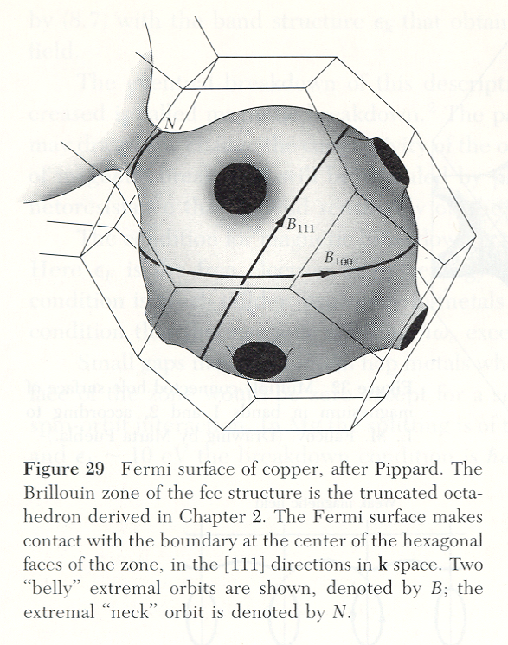
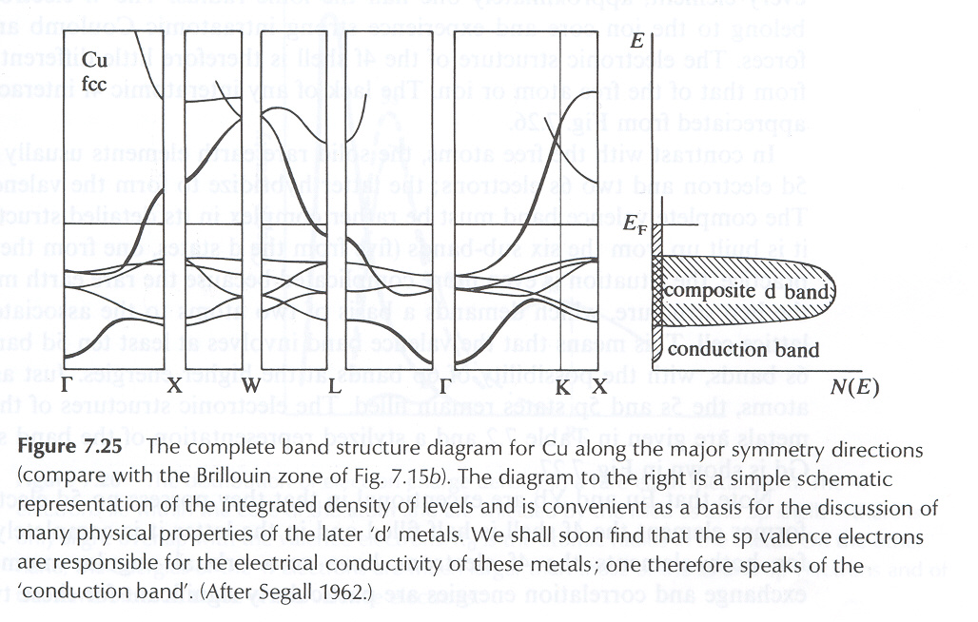
Energy Bands & Fermi Surface of Cu
Fermi surface of Cu is just a slightly distorted sphere → nearly-free electron model is a good approximation

Slide 28
Why the Energy Banding in Solids?
Key result of wave mechanics (Felix Bloch, 1928)
  Plane wave in a periodic potential
  Wave momentum only unique up to 2π/a
  Electron waves with allowed (k,E) can propagate (theoretically) unimpeded in perfectly periodic lattice

Slide 29
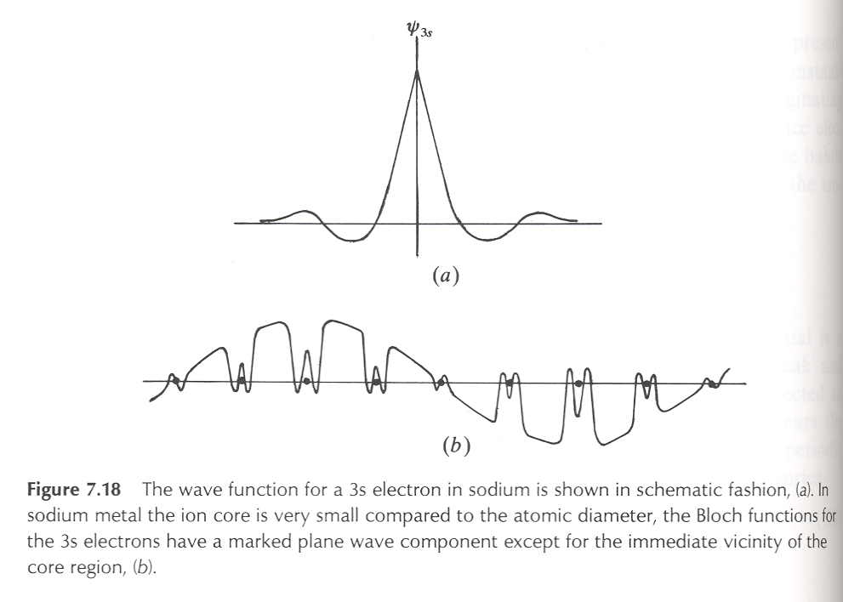
What Do Bloch Waves Look Like?
Periodic potential has a very small effect on the plane-wave character of a free electron wavefunction
Explains why the free electron model works well in most simple metals

Slide 30
Semiconductors Are Not Metals
empty states
E
empty
conduction
band
E_{F}
0
filled
valence
band
electron states
in isolated atom
electron states
in metal
electron states
in semiconductor
Filled bands cannot conduct current
What about at T > 0 K?
Where is the E_{F} of a semiconductor?

Slide 31
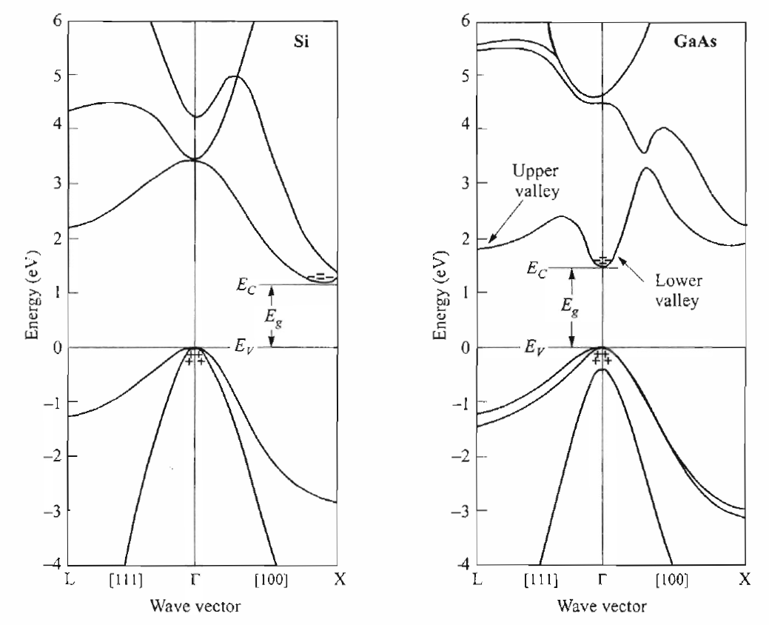
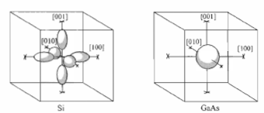
Semiconductor Energy Bands
Si
GaAs
Equi-energy surfaces at
bottom of conduction band
Si
GaAs
Silicon: six equivalent ellipsoidal pockets (m_{l}*, m_{t}*)
GaAs: spherical conduction band minimum (m*)

