Slide 1
Transient Thermal Response
Transient Models
  Lumped: Tenbroek (1997), Rinaldi (2001), Lin (2004)
  Introduce C_{TH} usually with approximate Green’s functions; heated volume is a function of time (Joy, 1970)
  Finite-Element methods
Instantaneous T rise
Due to very sharp heating pulse Δt ‹‹ V^{2/3}/α
More general
Simplest (~ bulk Si FET)
Temperature evolution anywhere (r,t) due to arbitrary heating function P(0<t’<t) inside volume V (dV’ ⊂ V) (Joy 1970)
Temperature evolution of a step-heated point source into silicon half-plane (Mautry 1990)

Slide 2
Instantaneous Temperature Rise
L
W
d
Instantaneous T rise
Due to very sharp heating pulse Δt ‹‹ V^{2/3}/α
Neglect convection & radiation
Assuming lumped body
Biot = hL/k << 1, internal resistance and T variation neglected, T(x) = T = const.

Slide 3
Lumped Temperature Decay
L
W
d
T decay
T(t=0) = T_{H}
After power input switched off
Assuming lumped body
R_{TH} = 1/hA
C_{TH} = cV
Time constant ~ R_{TH}C_{TH}

Slide 4
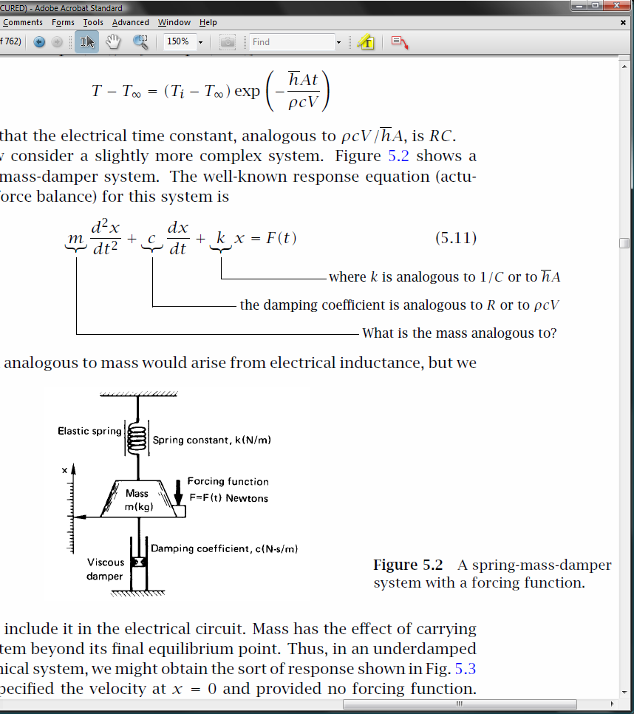
Electrical and Mechanical Analogy
Thermal capacitance (C = ρcV) normally spread over the volume of the body
When Biot << 1 we can lump capacitance into a single “circuit element” (electrical or mechanical analogy)
There are no physical elements analogous
to mass or inductance in thermal systems

Slide 5
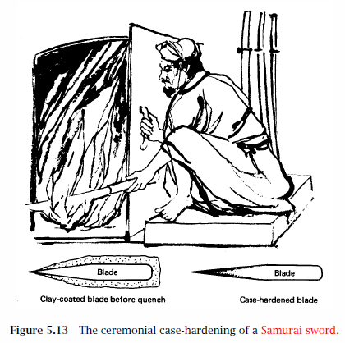
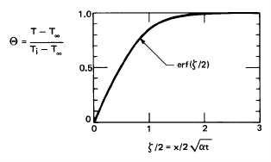
Transient Edge (Face) Heating
When is only the surface of a body heated?
I.e. when is the depth dimension “infinite”?
Note: Only heated surface B.C. is available
Lienhard book, http://web.mit.edu/lienhard/www/ahtt.html
Also http://www.uh.edu/engines/epi1384.htm

Slide 6
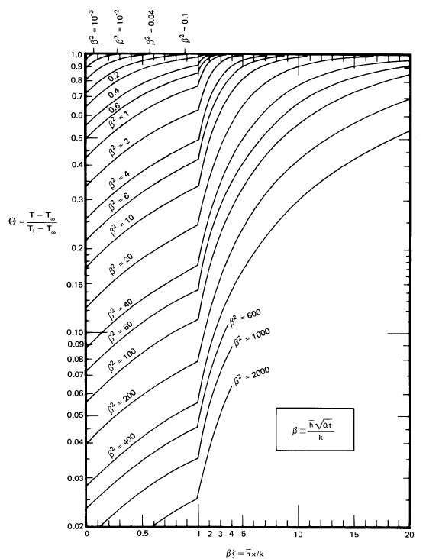
Transient Heating with Convective B.C.
If body is “semi-infinite” there is no length scale on which to build the Biot number
Replace Biot → (αt)^{1/2}
Note this reduces to previous slide’s simpler
expression (erf only) when h=0!

Slide 7
Transient Lumped Spreading Resistance
Source: Timo Veijola, http://www.aplac.hut.fi/publications/bec-1996-01/bec/bec.html
Point source of heat in material with k, c and α = k/c
Or spherical heat source, outside sphere
This is OK if we want to roughly approximate transistor as a sphere embedded in material with k, c
~ Bulk Si FET transient
Temperature evolution of a step-heated point source into silicon half-plane (Mautry 1990)
Characteristic diffusion length L_{D} = (αt)^{1/2}

Slide 8
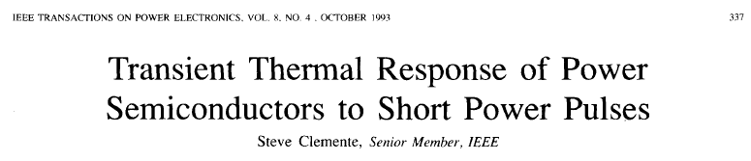
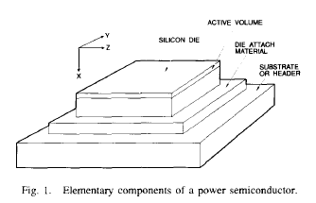
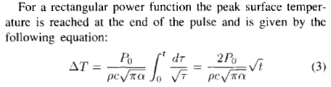
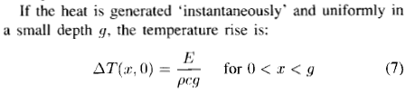

Transient of a Step-Heated Transistor
In general:
“Instantaneously” means short pulse time
vs. Si diffusion time (t < L_{D}²/α) or
short depth vs. Si diffusion length (L < (αt)^{1/2})
Carslaw and Jaeger (2e, 1986)

Slide 9
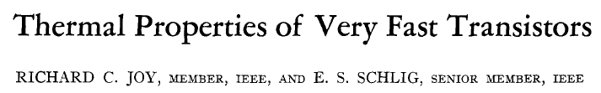
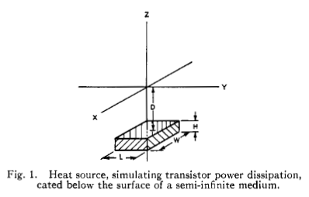
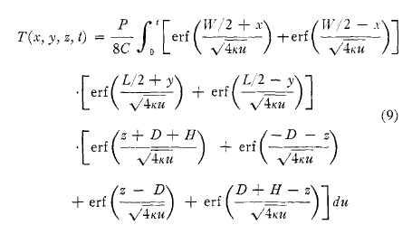
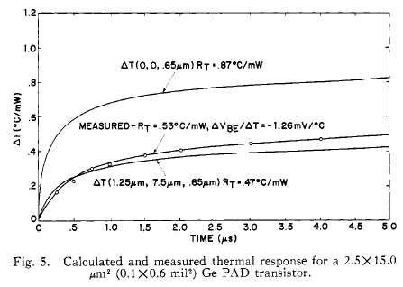
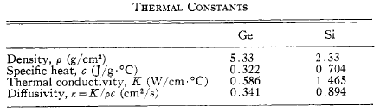
Device Thermal Transients (3D)

Slide 10
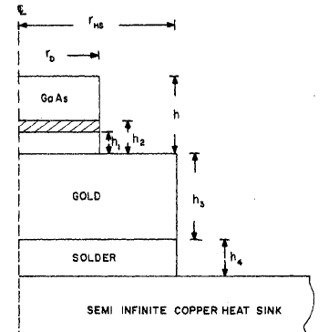
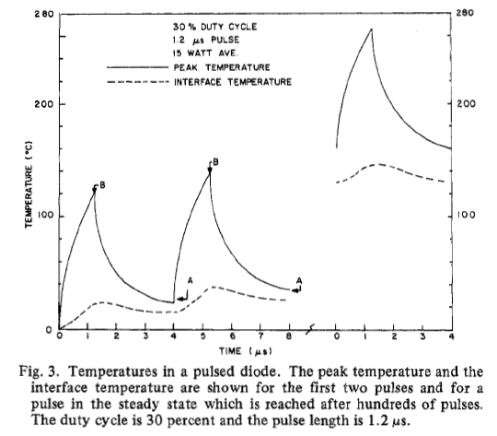
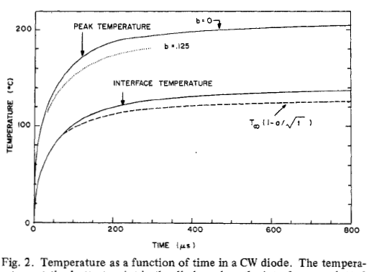
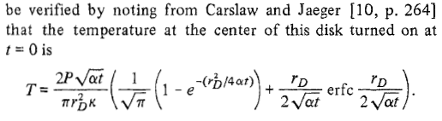
Temperature of Pulsed Diode
Holway, TED 27,
433 (1980)

Slide 11
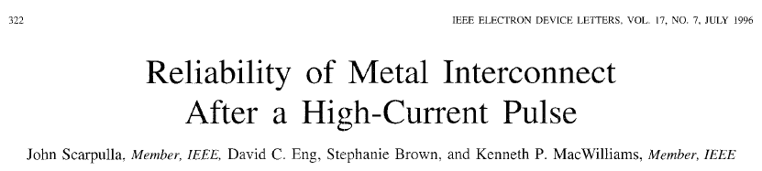
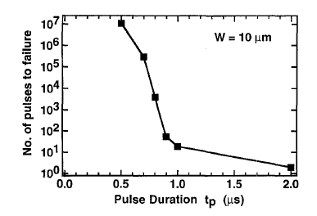
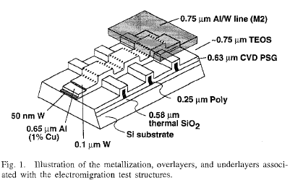
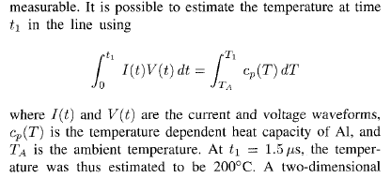
Interconnect Reliability

Slide 12
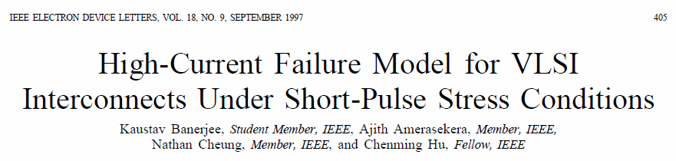
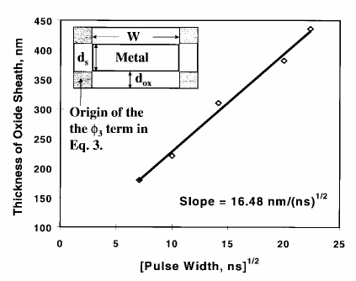
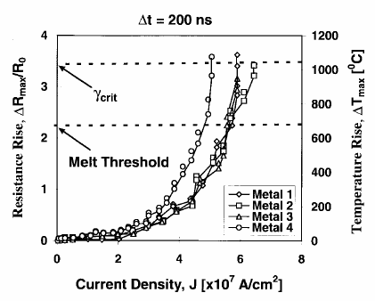


Transient of a Step-Heated Interconnect
When to use “adiabatic
approximation” and
when to worry about
heat dissipation into
surrounding oxide

Slide 13
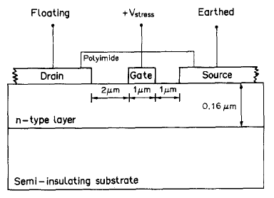
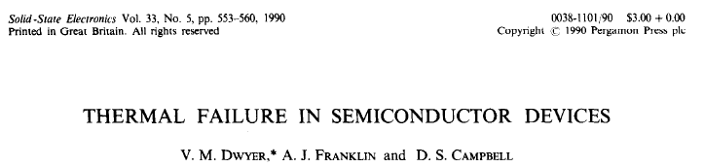
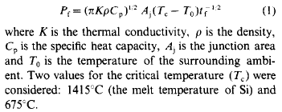
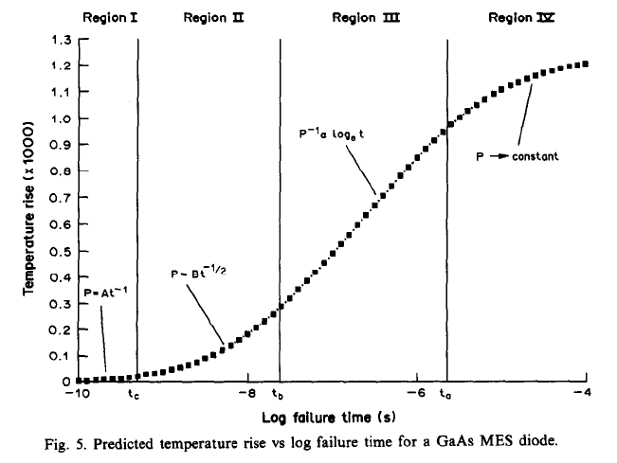
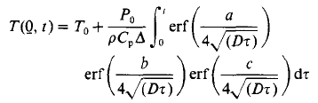

Transient Thermal Failure

Slide 14
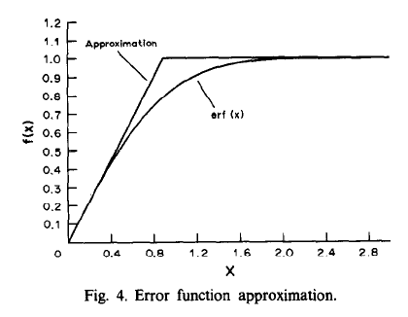
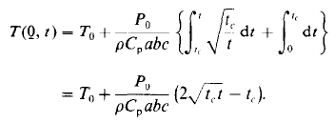
Understanding the sqrt(t) Dependence
Physical = think of the heated volume as it expands ~ (αt)^{1/2}
Mathematical = erf approximation

Slide 15
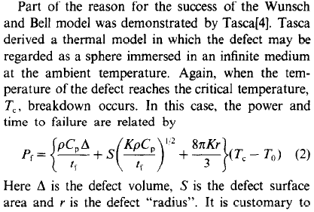
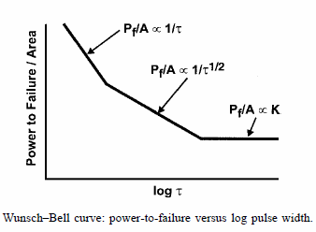

Time Scales of Thermal Device Failure
Three time scales:
  “Small” failure times: all heat dissipated within defect, little heat lost to surrounding ~ adiabatic (ΔT ~ Pt)
  Intermediate time: heating up surrounding layer of (αt)^{1/2}
  “Long” failure time ~ steady-state, thermal equilibrium established: ΔT ~ P*const. = PR_{TH}

Slide 16
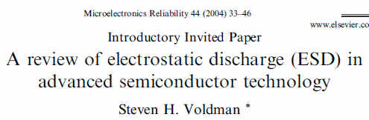
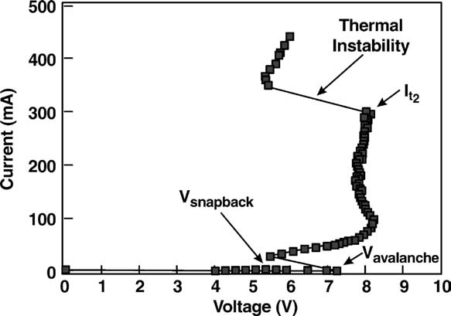
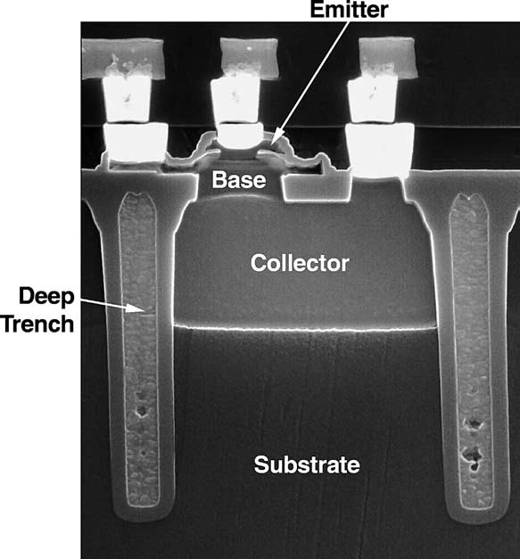
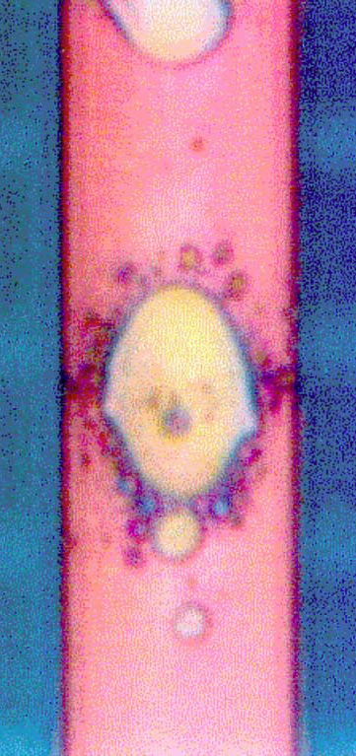
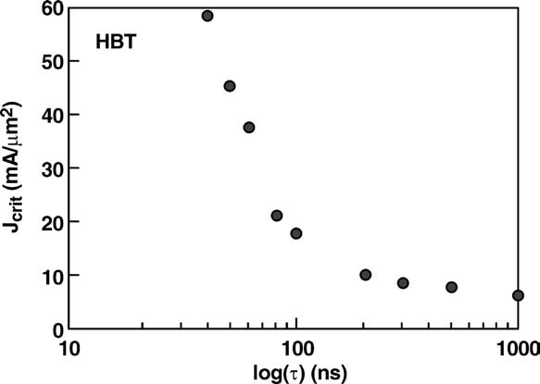
Ex: Failure of SiGe HBT and Cu IC
Wunsch-Bell curve of HBT

Slide 17
Ex: Failure of Al/Cu Interconnects
Banerjee et al., IRPS 2000
Ju & Goodson, Elec. Dev. Lett. 18, 512 (1997)
Fracture due to the expansion of critical volume of molten Al/Cu. (@ 1000 ⁰C)

Slide 18
Temperature Rise in Vias
S. Im, K. Banerjee, and K. E. Goodson, IRPS 2002
Via and interconnect dimensions are not consistent from a heat generation / thermal resistance perspective, leading to hotspots. New model accounts for via conduction and Joule heating and recommends dimensions considering temperature and EM lifetime.
Based on ITRS global lines of a 100 nm technology node
(Left: ANSYS simulation. Right: Closed-Form Modeling)

Slide 19
Time Scales of Electrothermal Processes
Source: K. Goodson

Slide 20



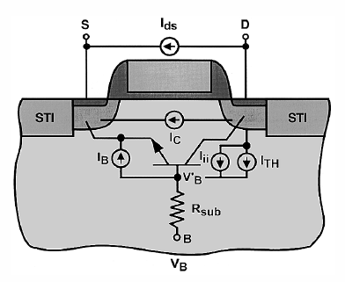
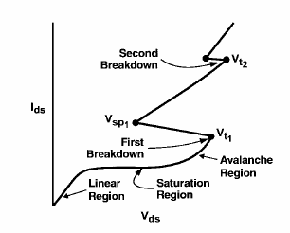
ESD: Electrostatic Discharge
J. Vinson & J. Liou, Proc. IEEE 86, 2 (1998)
High-field damage
High-current damage
Thermal runaway
…
…

Slide 21
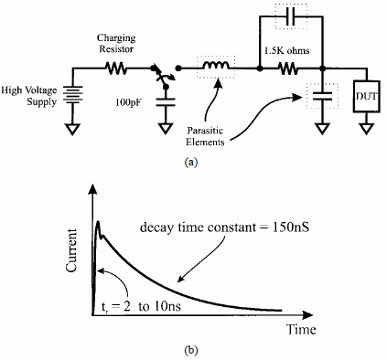
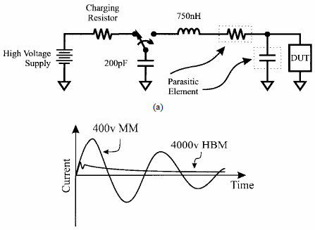
Common ESD Models
Gate
J. Vinson & J. Liou, Proc. IEEE 86, 2 (1998)
Source
Drain
Combined, transient,
electro-thermal device models
Lumped: Human-Body Model (HBM)
Lumped: Machine Model (MM)

Slide 22

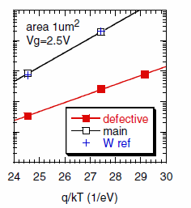
Reliability
Source: M. Stan
The Arrhenius Equation: MTF=A*exp(E_{a}/k_{B}T)
  MTF: mean time to failure at T
  A: empirical constant
  E_{a}: activation energy
  k_{B}: Boltzmann’s constant
  T: absolute temperature
Failure mechanisms:
  Die metalization (Corrosion, Electromigration, Contact spiking)
  Oxide (charge trapping, gate oxide breakdown, hot electrons)
  Device (ionic contamination, second breakdown, surface-charge)
  Die attach (fracture, thermal breakdown, adhesion fatigue)
  Interconnect (wirebond failure, flip-chip joint failure)
  Package (cracking, whisker and dendritic growth, lid seal failure)
Most of the above increase with T (Arrhenius)
Notable exception: hot electrons are worse at low temperatures
E_{a} = 1.1 eV
E_{a} = 0.7 eV

Slide 23
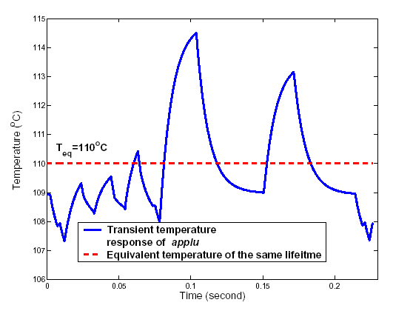
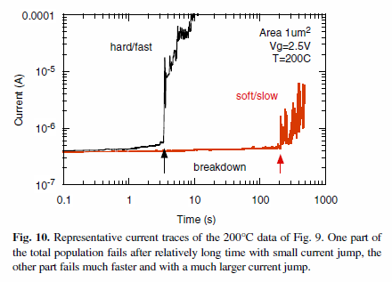
Improved Reliability Analysis
M. Stan (2007), Van der Bosch, IEDM (2006)
There is NO “one size fits all” reliability estimate approach
Typical reliability lifetime estimates done at worst-case temperature (e.g. 125 ºC) which is an OVERDESIGN
Apply in a “lumped” fashion at the granularity of microarchitecture units
life consumption rate

Slide 24
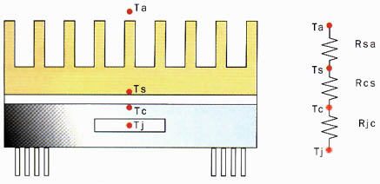
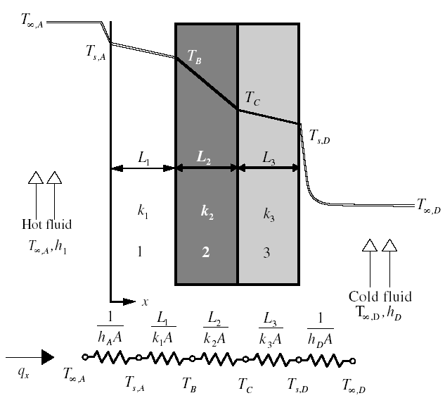
Combined Package Model
Steady-state:
T_{j} – junction temperature
T_{c} – case temperature
T_{s} – heat sink temperature
T_{a} – ambient temperature

Slide 25
Thermal Design Summary
Temperature affects performance, power, and reliability
Architecture-level: conduction only
  Very crude approximation of convection as equivalent resistance
  Convection, in general: too complicated, need CFD!
Use compact models for package
Power density is key
Temporal, spatial variation are key
Hot spots drive thermal design

